Slide 1

Data Acquisition and Preservation
Digital forensics is the science of recovering and analyzing digital evidence from electronic devices. It plays a crucial role in investigating crimes, recovering lost data, and ensuring the integrity of digital information.

Slide 2

Data Acquisition and Preservation
Volatile Data Capture
Hardware Forensics
Chain of Custody
Data Duplication
Strict protocols must be followed to maintain the integrity of digital evidence from collection to presentation in court. Proper documentation and secure handling are critical.
Creating bit-for-bit forensic images of storage media is essential, but can be time-consuming and challenging with large or encrypted volumes.
One of the most challenging aspects is capturing volatile data on running systems before it is lost. This includes memory, network traffic, and running processes that vanish once the system is powered off.
Extracting data from damaged or hidden storage media like SSDs, embedded systems, and IoT devices requires specialized tools and techniques to avoid compromising evidence.

Slide 3
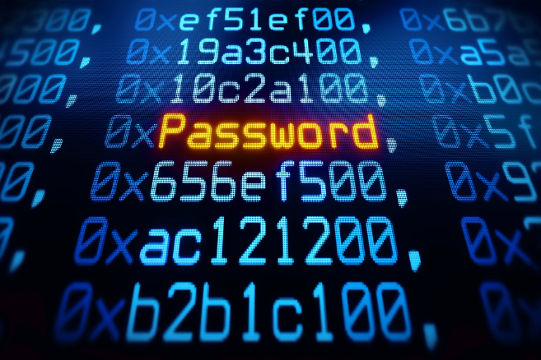
Encryption and Password Cracking
Encryption is a critical challenge in digital forensics, as it can obscure or protect sensitive data from investigators. Password cracking techniques, such as brute-force attacks and dictionary-based methods, are used to bypass encryption and gain access to encrypted data.
Overcoming encryption often requires extensive computing power, specialized software, and deep technical expertise. Forensic examiners must stay up-to-date on the latest encryption algorithms and cracking methods to effectively tackle this obstacle.

Slide 4

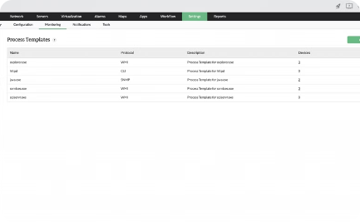

Volatile Data Analysis
Memory Acquisition
Process and Thread Analysis
Network Activity Monitoring
Capturing a live system's volatile memory is critical for preserving ephemeral evidence that can vanish when the system is powered off.
Examining running processes, their connections, and any suspicious activity can reveal malware, unauthorized access, and other cyber threats.
Analyzing network packets, protocols, and communication patterns can uncover evidence of data exfiltration, command and control channels, and other malicious network activities.

Slide 5
Non-volatile Data Analysis
Disk Imaging
File System Analysis
Capturing a complete forensic image of the hard drive is crucial to preserve evidence and enable in-depth analysis without modifying the original data.
Examining file system structures, metadata, and deleted files can reveal important artifacts and trace user activities on the system.
Data Carving
Registry Parsing
Recovering fragmented or deleted files through data carving techniques can uncover hidden information valuable to the investigation.
Analyzing the Windows registry can provide insights into system configuration, user accounts, and application execution history.

Slide 6

Network Traffic Forensics
Analyzing network traffic is crucial in digital forensics, as it can reveal crucial evidence of cyberattacks, data exfiltration, and other malicious activities. Network traffic analysis involves capturing, filtering, and inspecting network packets to reconstruct communication patterns, identify suspicious activity, and uncover hidden data transfers.
Challenges in this field include the sheer volume of network data, the need for specialized tools and expertise, and the potential for encrypted or obfuscated network traffic that can conceal malicious activity. Overcoming these challenges requires a deep understanding of network protocols, forensic techniques, and data analysis methodologies.

Slide 7
Mobile Device Forensics
1
Data Acquisition
2
Encryption Hurdles
Extracting data from mobile devices, like smartphones and tablets, can be challenging due to their proprietary hardware and software.
Advanced encryption on mobile devices makes it difficult to access and analyze critical evidence, often requiring specialized tools and techniques.
3
Volatile Data Recovery
4
App-Specific Forensics
Retrieving volatile data, such as active processes, running apps, and memory contents, is crucial but can be time-sensitive and complex.
Investigating mobile apps, their data, and their communications is essential, but requires extensive knowledge of the platforms and app ecosystems.

Slide 8

Cloud Forensics
Gathering digital evidence from the cloud presents unique challenges. Accessing data stored on remote servers, ensuring data integrity, and navigating complex legal and jurisdictional issues are critical considerations in cloud forensics.
Techniques like virtual machine imaging, API-based data collection, and network traffic analysis are essential for conducting thorough cloud-based investigations.

Slide 9




Courtroom Presentation and Testimony
Preparing Compelling Visuals
Crafting visuals that effectively communicate complex digital forensic findings is crucial. Leverage multimedia, animations, and interactive elements to engage the jury and judges.
Delivering Testimony Confidently
Experts must convey digital evidence clearly and confidently, anticipating cross-examination. Thorough preparation and practice are key to delivering impactful testimony.
Addressing Technical Challenges
Navigating the courtroom's technical setup, handling evidence, and responding to objections require adaptability. Experts must be ready to troubleshoot issues on the fly.

Slide 10



Ethical and Legal Considerations
Legal Compliance
Ethical Practices
Expert Testimony
Digital forensics practitioners must adhere to strict legal guidelines to ensure evidence admissibility and protect individual privacy rights.
Maintaining the highest ethical standards is critical, including respecting data integrity, minimizing invasiveness, and prioritizing justice over personal gain.
Forensic examiners may be called upon to provide expert witness testimony in court, requiring meticulous documentation and unwavering objectivity.

